Slide 1
Week 4 Control Statements Part 1
CS 331
An introduction to C++ and Object-Oriented Programming
MD Romael Haque

Slide 2
Introduction to Loops
A loop is part of a program that repeats.
A loop is a control structure that causes a statement or group of statements to repeat.
C++ has three looping control structures: the while loop, the do-while loop, and the for loop. The difference between each of these is how they control the repetition.

Slide 3
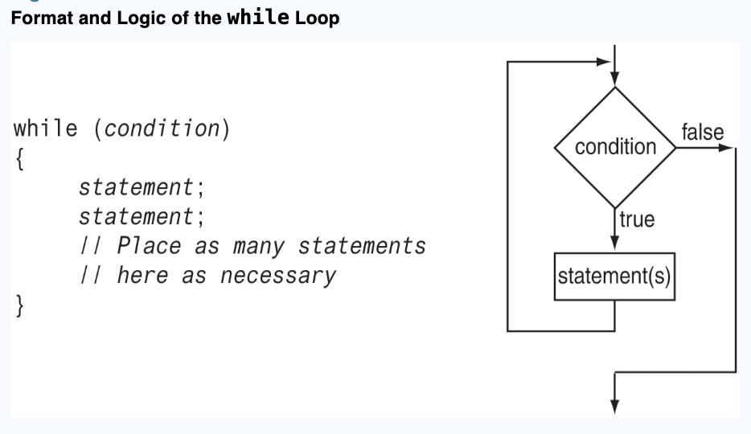
The while Loop
The while loop has two important parts:
An expression that is tested for a true or false value and
A statement or block that is repeated as long as the expression is true.

Slide 4
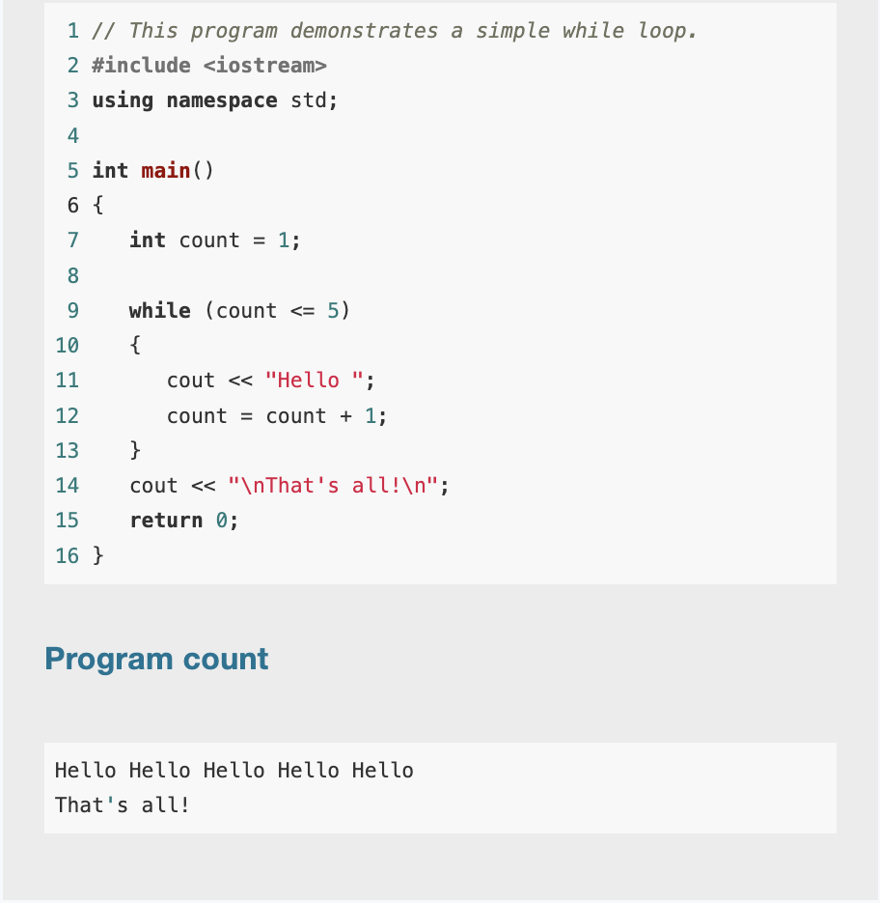
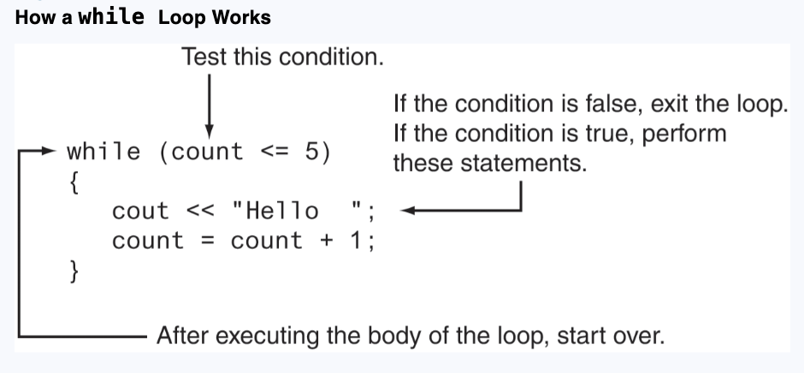
The while loop - example

Slide 5
The while loop
The while loop is a pretest loop. This means it tests its condition before each iteration. If the test expression is false to start with, the loop will never iterate.
int count = 6;
while (count <= 5)
{ cout << "Hello "; count = count + 1;
}

Slide 6
Programming Style and the while Loop
If there is only one statement repeated by the loop, it should appear on the line after the while statement and be indented one level.
If the loop repeats a block of statements, the block should begin on the line after the while statement, and each line inside the braces should be indented.
Coorect but avoid this –
while (count <= 5) { cout << "Hello "; count = count + 1; }

Slide 7
Exercise
You are tasked with writing a C++ program to help a teacher determine the letter grades for multiple students based on their test scores. The program will ask the teacher how many students need their grades calculated, then prompt for each student's numeric test score. Based on the numeric score, the program will assign a letter grade following the standard grading scale:
90 and above: A
80 to 89: B
70 to 79: C
60 to 69: D
Below 60: F

Slide 8
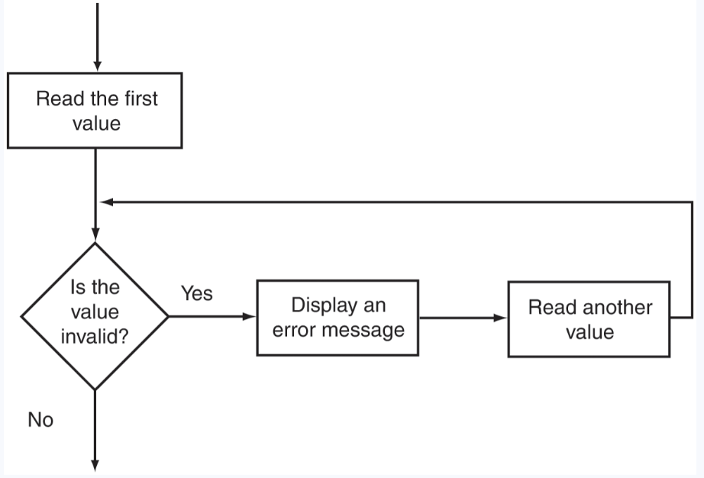
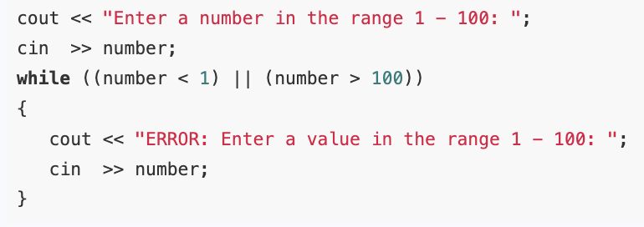
Using the while Loop for Input Validation
The while loop can be used to create input routines that repeat until acceptable data is entered.

Slide 9
Exercise
Write a program to calculate the number of soccer teams a youth league may create, based on the given number of available players and a minimum and maximum number of players per team.

Slide 10

The Increment and Decrement Operators
C++ provides a pair of operators for incrementing and decrementing variables.
To increment a value means to increase it, and to decrement a value means to decrease it.
General example –
C++ provides a pair of operators to do this. They are both unary operators. That means they operate on just one operand.
The ++ operator increases its operand’s value by 1. The -- operator decreases its operand’s value by 1.

Slide 11
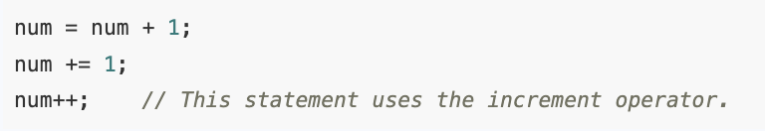
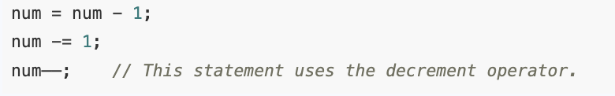
The Increment and Decrement Operators
Here are three different ways to increment the value of the variable num by 1.
Here are three different ways to decrement it by 1
Notice that there is no space between the two plus signs in ++ or between them and the name of the variable being incremented.
Note also that the ++ and −− operators cannot operate on literals. They can only operate on an lvalue, such as a variable.

Slide 12
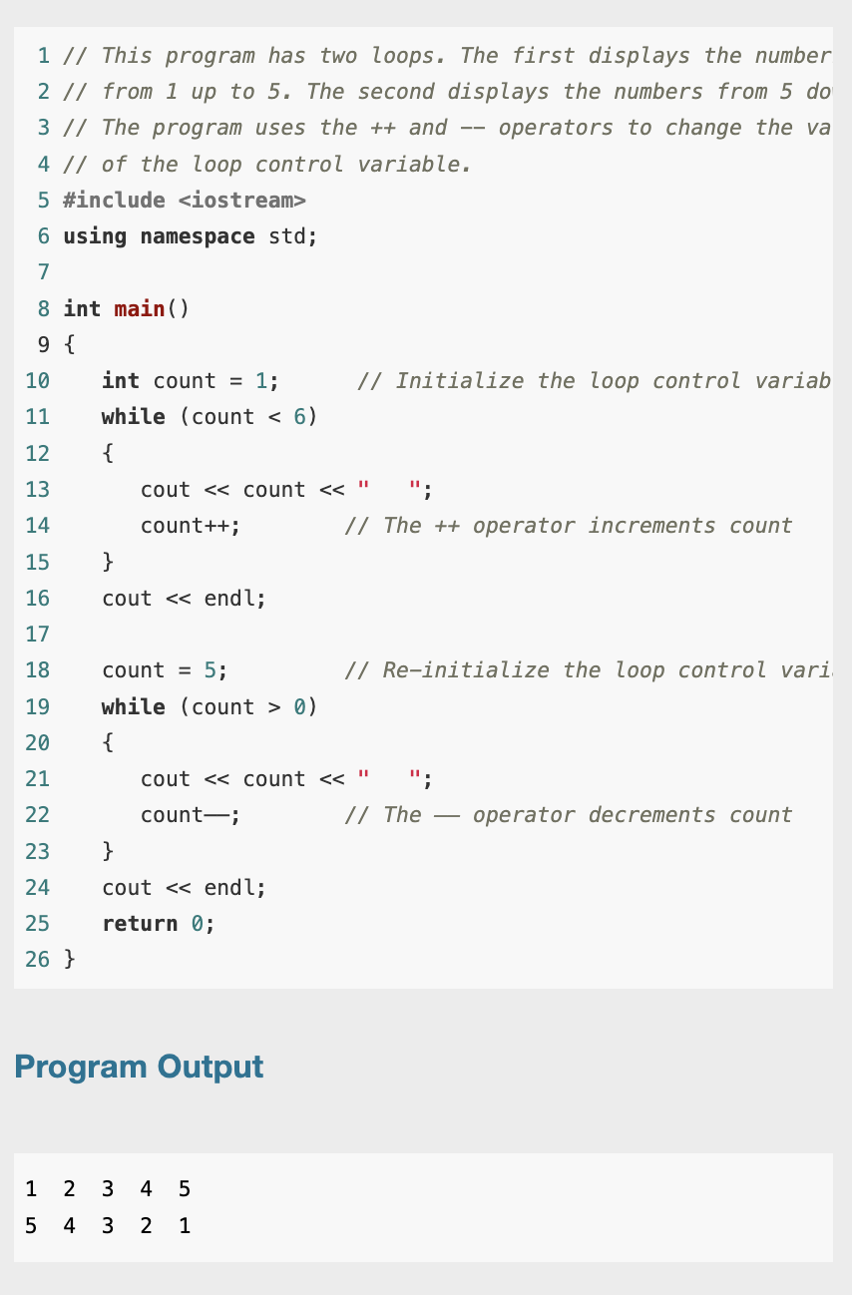
Example

Slide 13
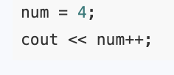
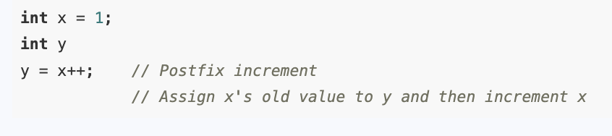
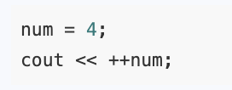
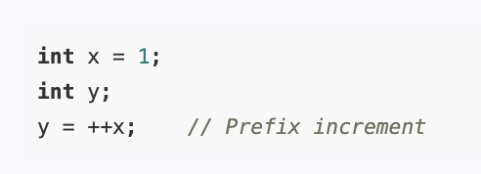
Postfix and Prefix Modes
Our examples so far show the increment and decrement operators used in postfix mode, which means the operator is placed after the variable. The operators also work in prefix mode, where the operator is placed before the variable name.
++countUp;
−−countDown;
Example: where it might make a difference -

Slide 14
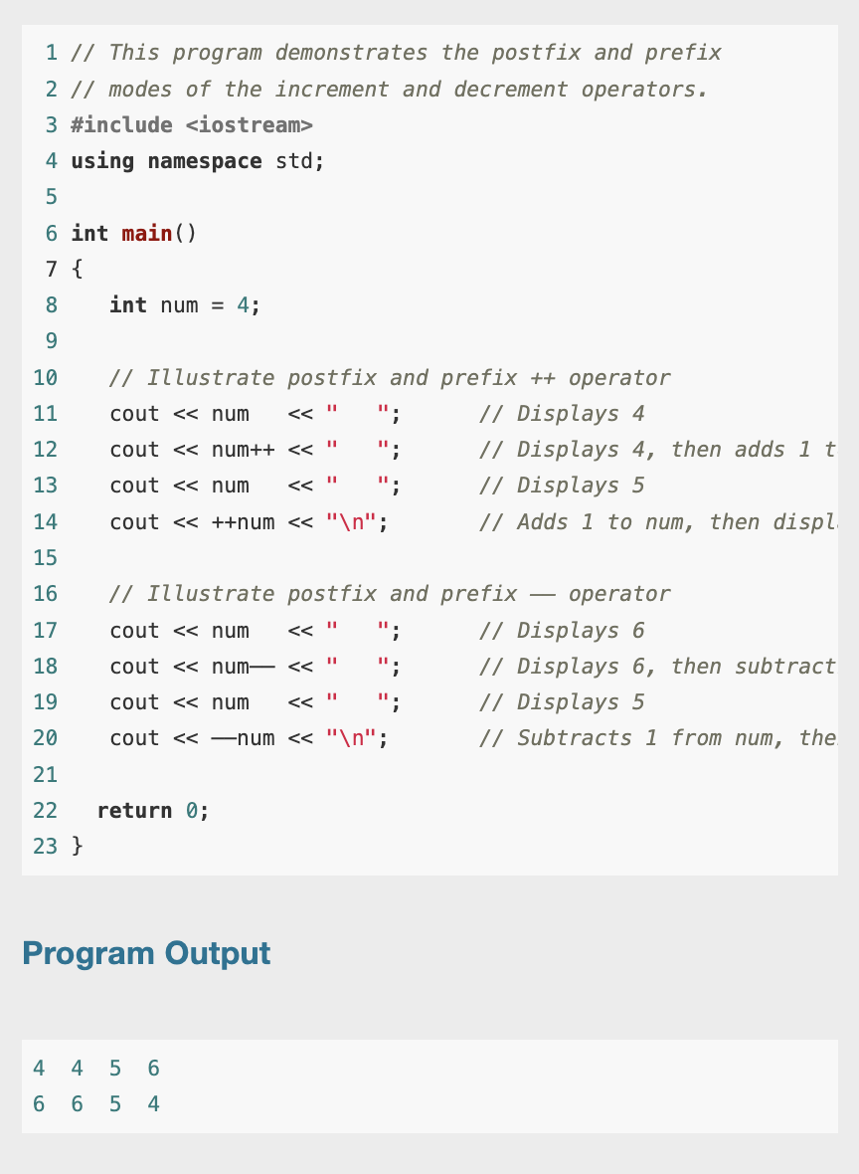
Example

Slide 15
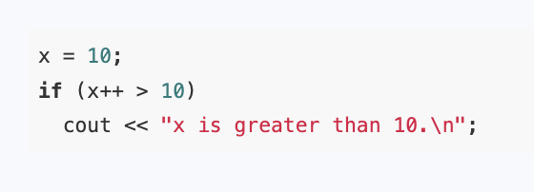
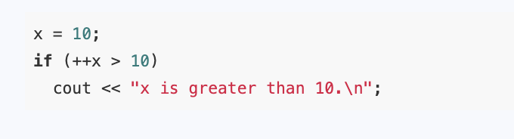
Using ++ and −− in Relational Expressions

Slide 16
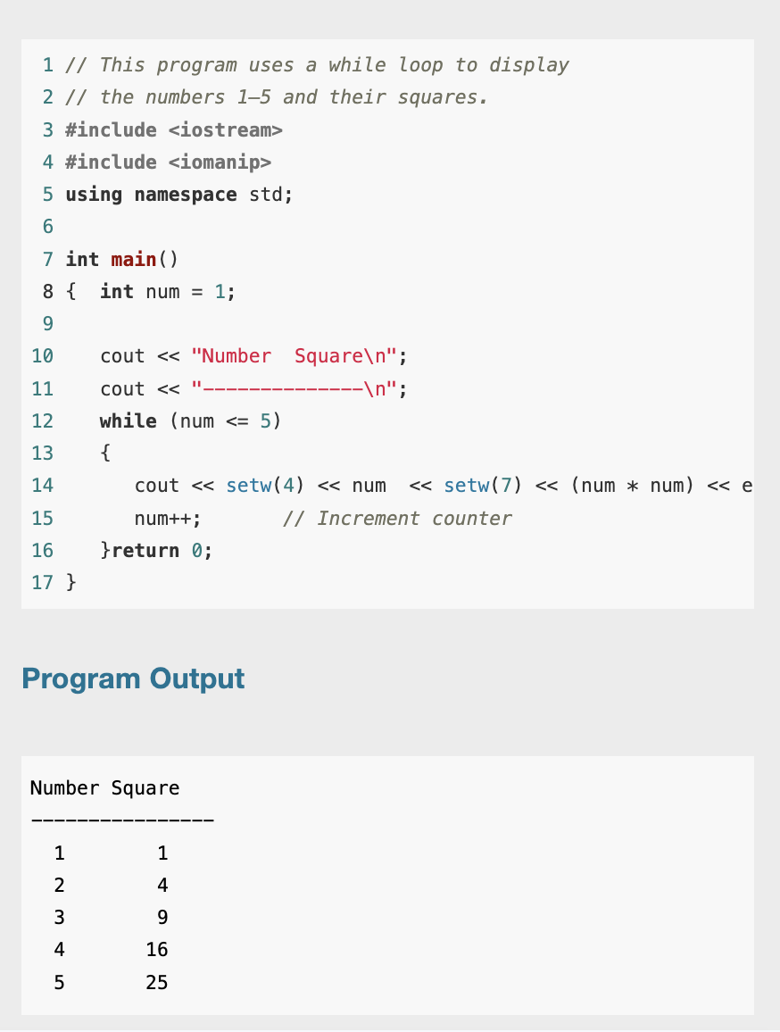
Counters
A counter is a variable that is regularly incremented or decremented each time a loop iterates.

Slide 17
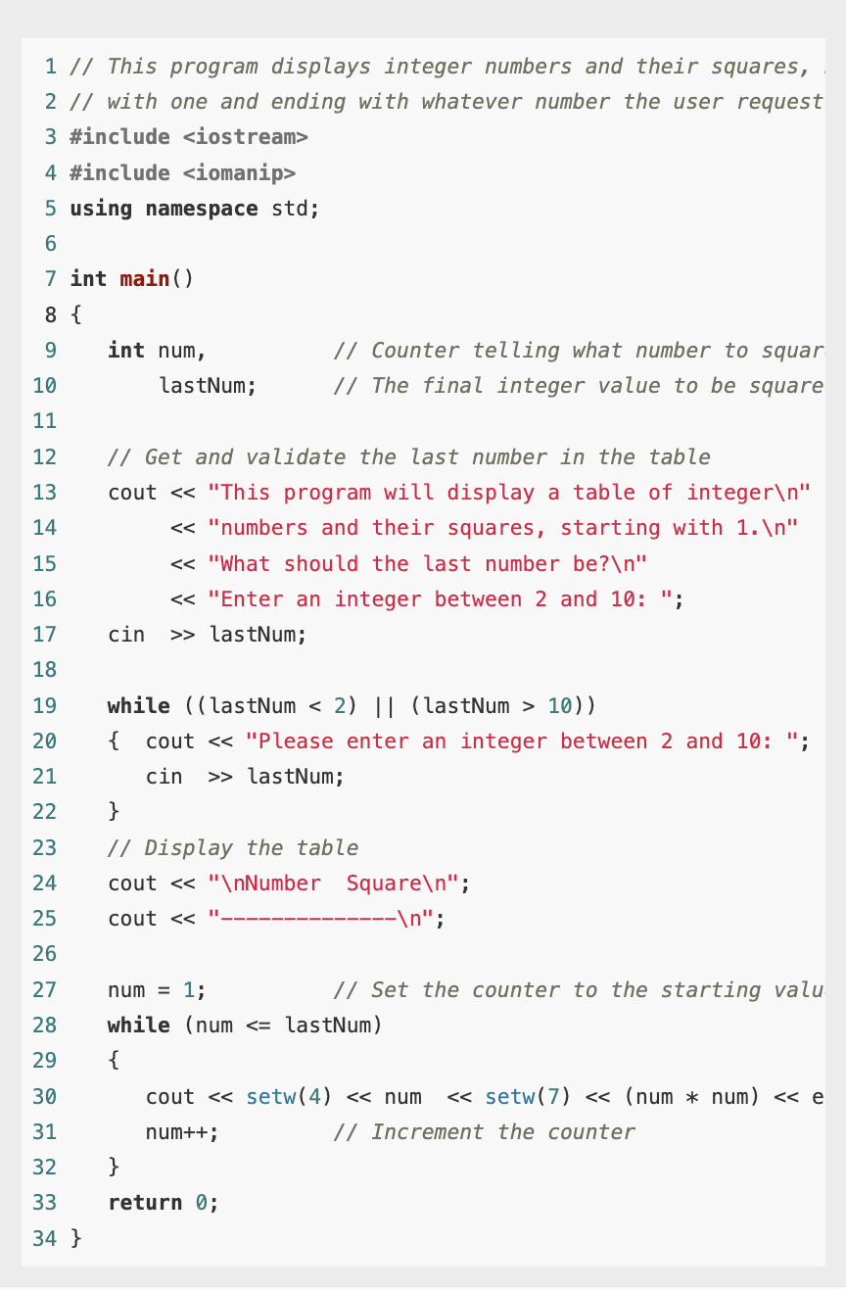
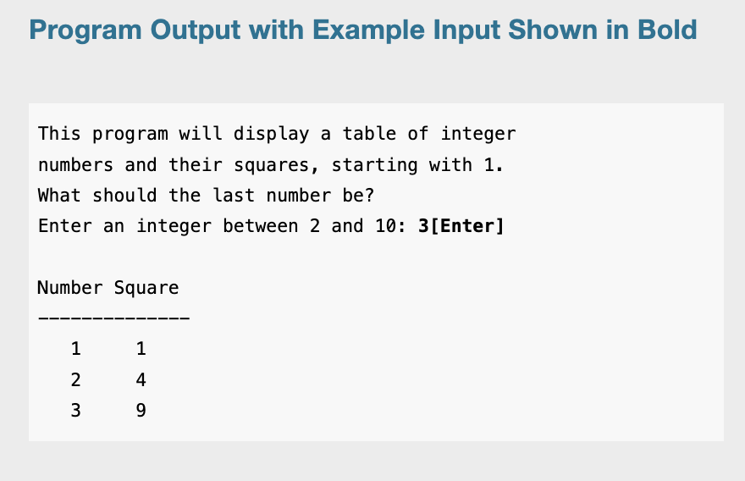
Letting the User Control the Loop

Slide 18
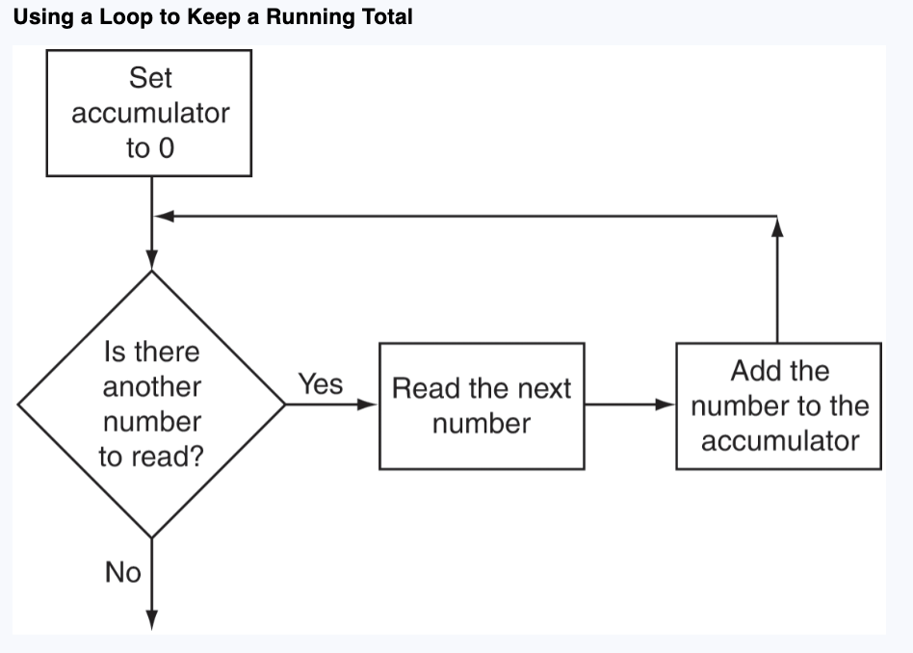
Keeping a Running Total
A running total is a sum of numbers that accumulates with each iteration of a loop.
The variable used to keep the running total is called an accumulator.
When the loop finishes, the accumulator will contain the total of the numbers read by the loop.
Notice that the first step in the flowchart is to set the accumulator variable to 0. This is a critical step. Each time the loop reads a number, it adds it to the accumulator.
If the accumulator starts with any value other than 0, it will not contain the correct total when the loop finishes.

Slide 19
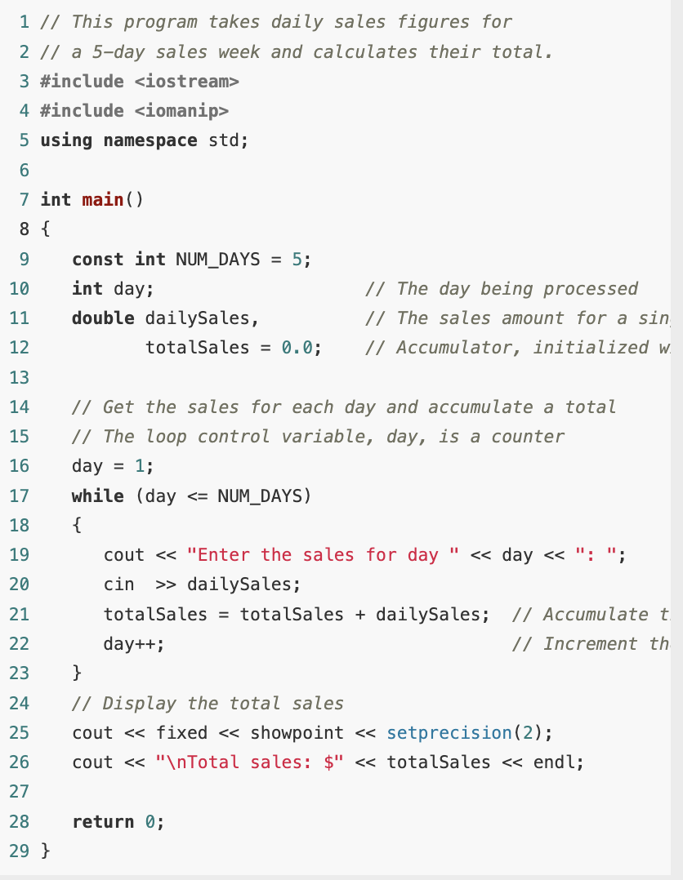
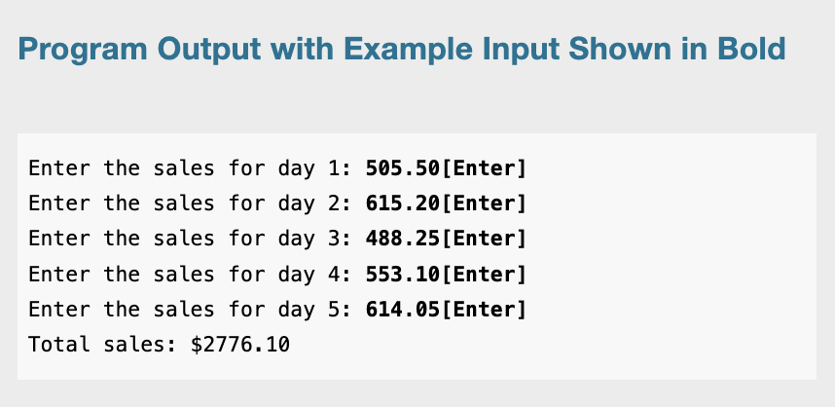
Example

Slide 20
Sentinels
A sentinel is a special value that marks the end of a list of values.
A sentinel is a special value that cannot be mistaken for a member of the list and that signals that there are no more values to be entered.
The loop that allows the data to be input continues iterating until the user enters the sentinel. Then the loop terminates. This type of loop is called a sentinel-controlled loop.

Slide 21
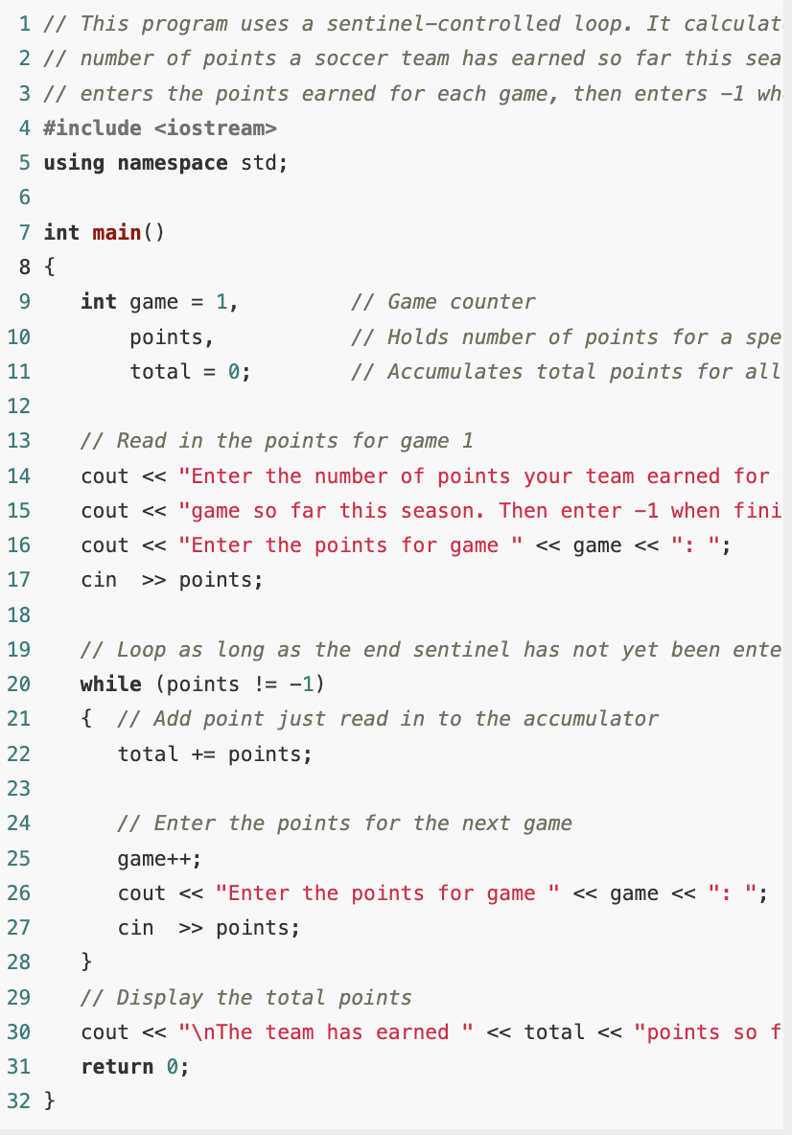
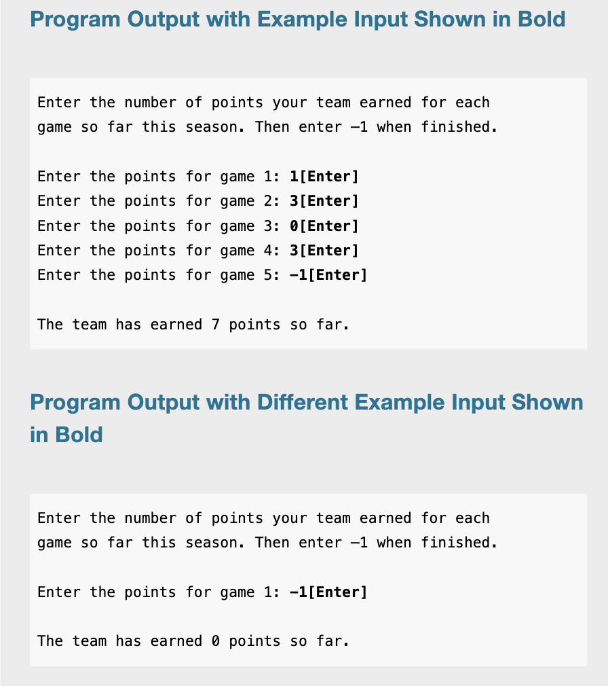
Example

Slide 22
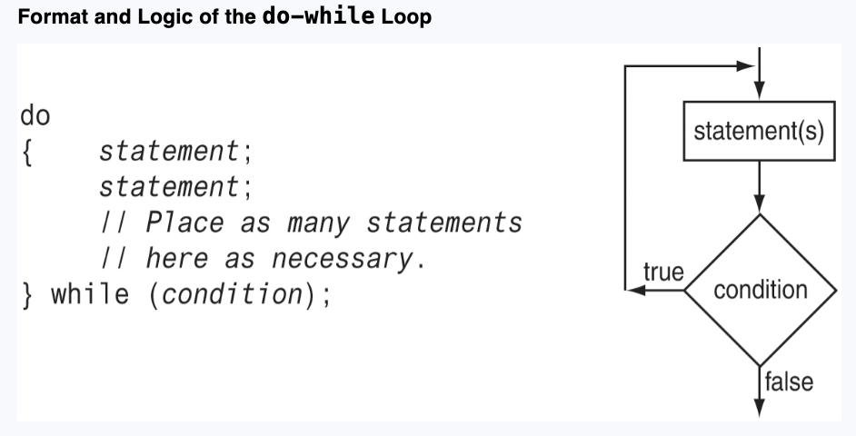
The do-while Loop
The do-while loop is a post-test loop, which means its expression is tested after each iteration.

Slide 23
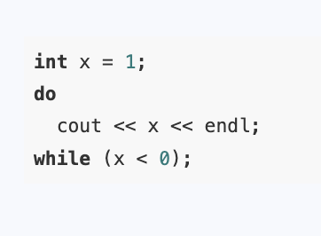
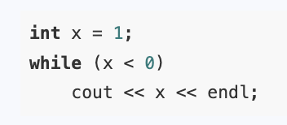
The do-while Loop
It’s a post-test loop. Therefore a do-while always performs at least one iteration, even if the test expression is false at the start.
You should use the do-while loop when you want to make sure the loop executes at least once.

Slide 24
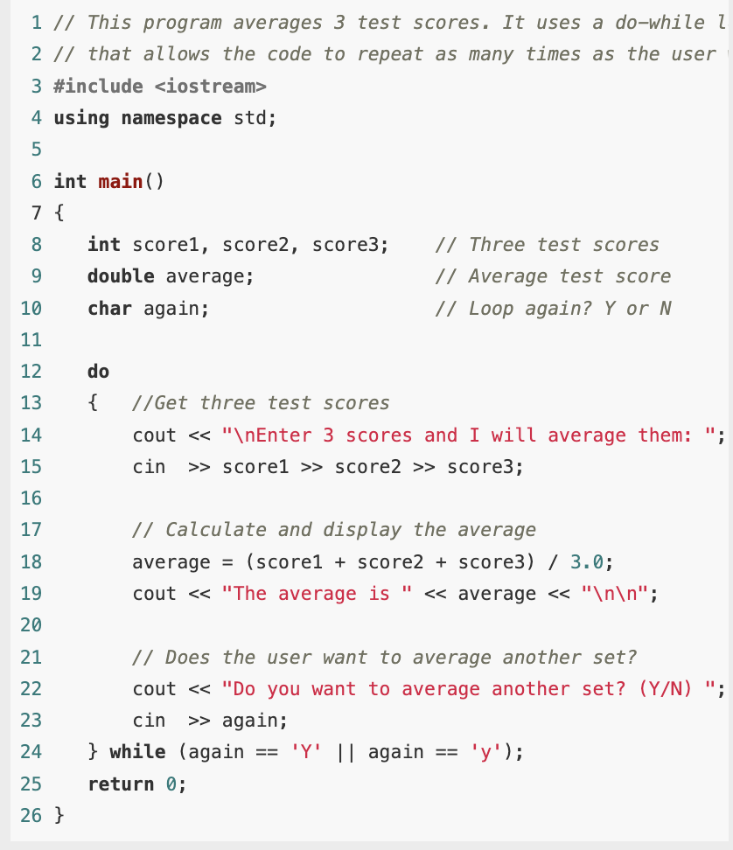
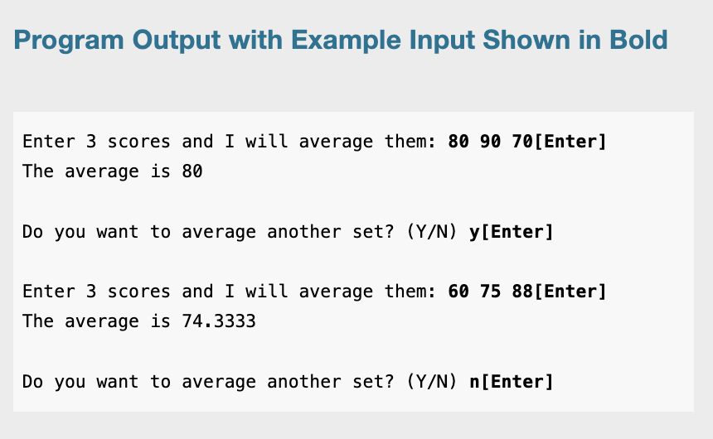
Example
This can be done easily with toupper function – self study

Slide 25
Using do-while with Menus
It Will allow to run the program repeatedly until you decides to close it.
Example: health-club membership menu option

Slide 26
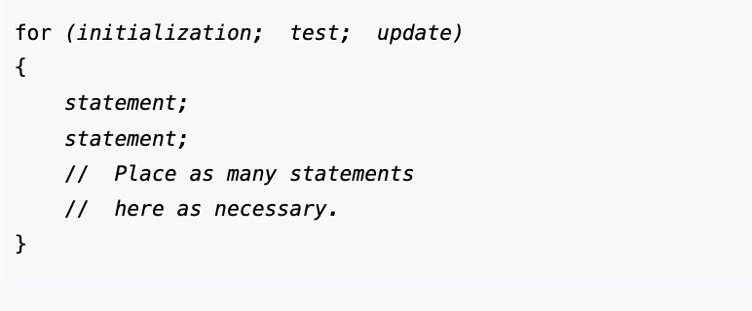
The for Loop
The for loop is a pretest loop that combines the initialization, testing, and updating of a loop control variable in a single loop header.
Because the for loop tests its test expression before it performs an iteration, it is possible to write a for loop in such a way that it will never iterate. It’s a pretest loop.

Slide 27

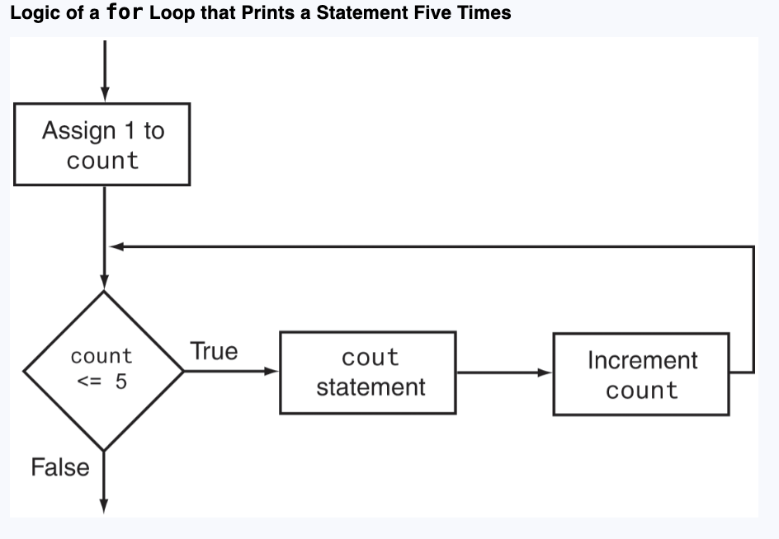
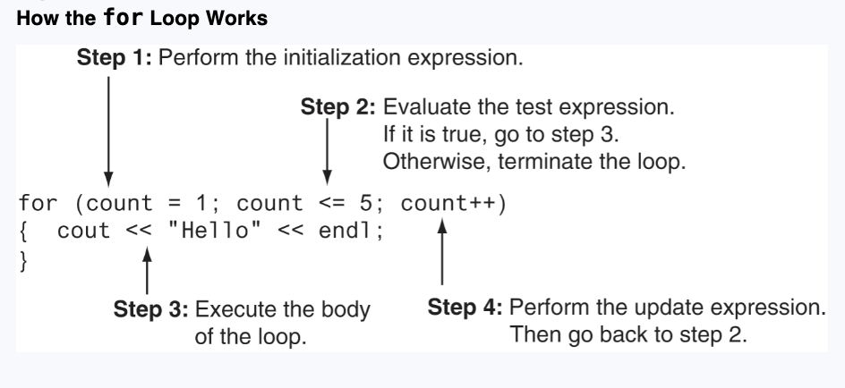
The for loop

Slide 28
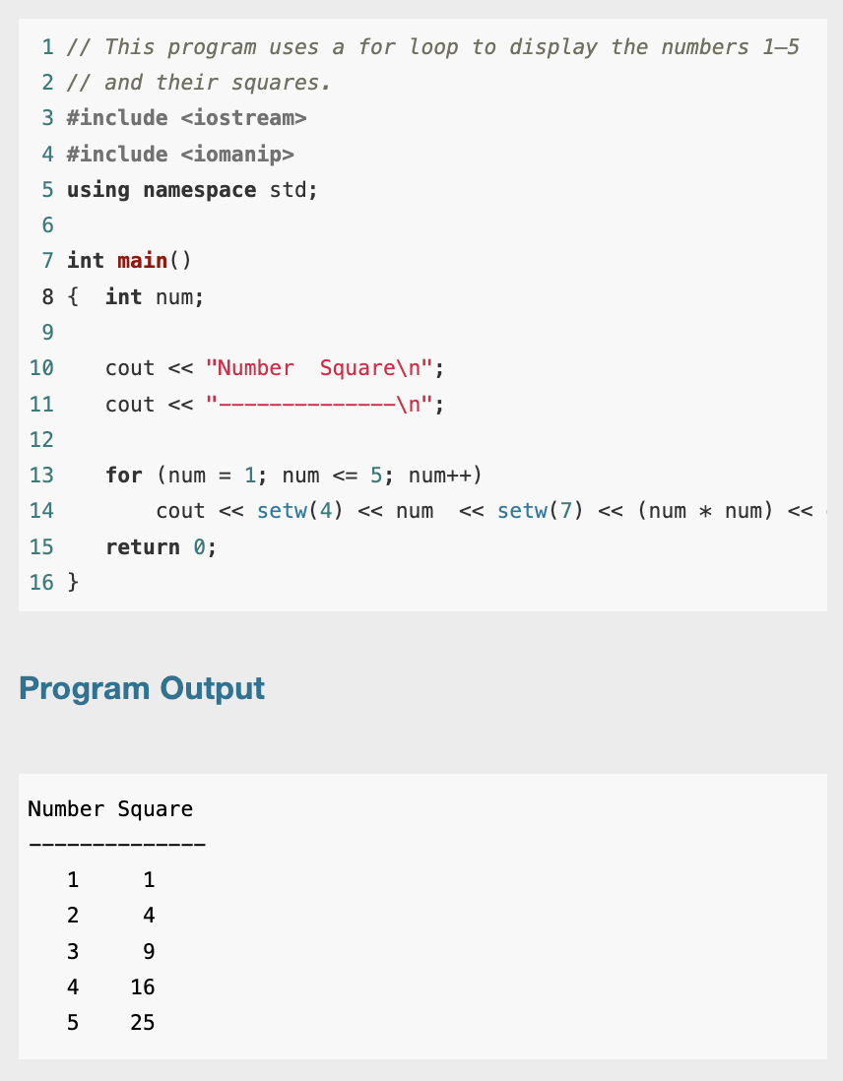
Example

Slide 29
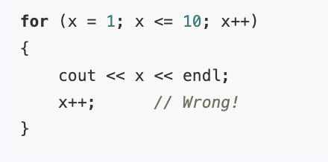
Avoid Modifying the Counter Variable in the Body of the for Loop

Slide 30
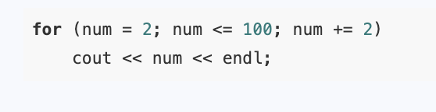
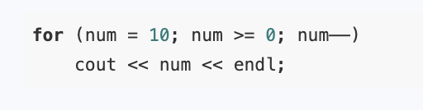
Other Forms of the Update Expression

Slide 31
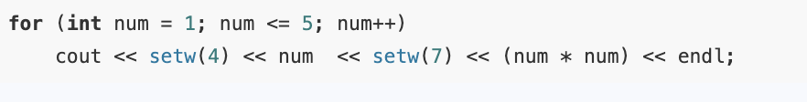
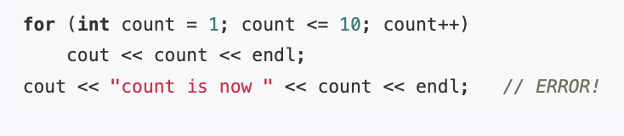
Defining a Variable in the for Loop’s Initialization Expression

Slide 32
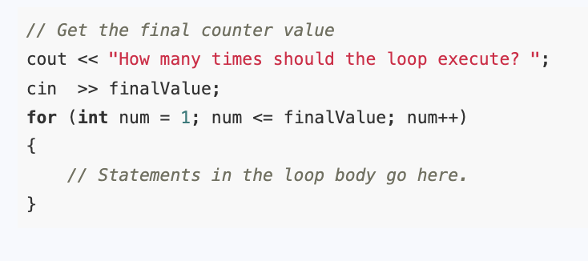
Creating a User-Controlled for Loop

Slide 33
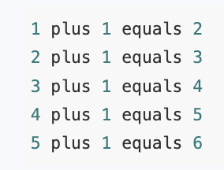
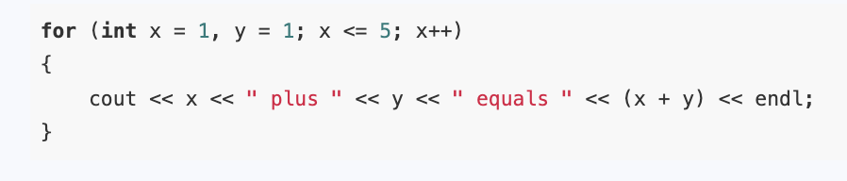
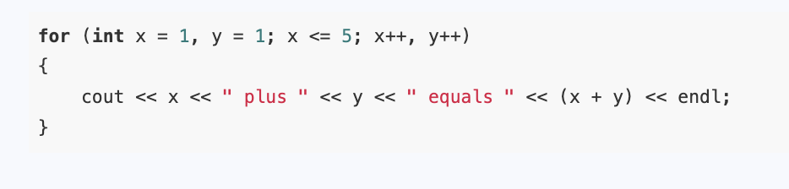
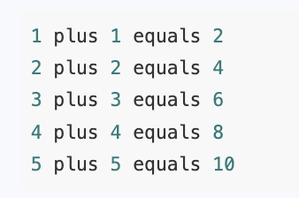
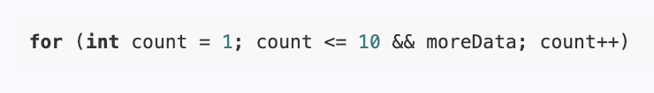
Using Multiple Statements in the Initialization and Update Expressions
1
2
3

Slide 34
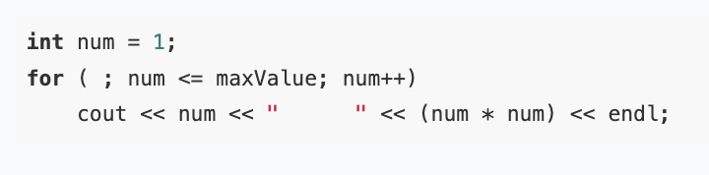
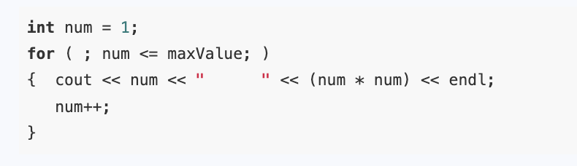

Omitting the for Loop’s Expressions or Loop Body
1
2
Just like a while loop
3

Slide 35
Deciding Which Loop to Use
Although most repetitive algorithms can be written with any of the three types of loops, each works best in different situations.

Slide 36
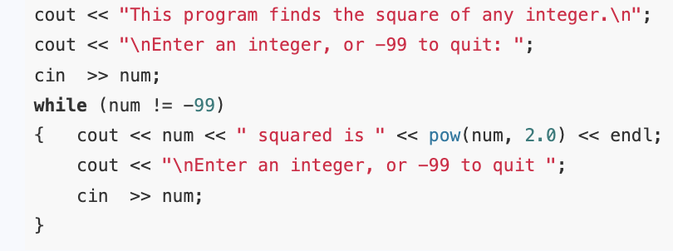
Deciding Which Loop to Use – While loop
The while loop is a pretest loop. It is ideal in situations where you do not want the loop to iterate if the test condition is false from the beginning. For example, validating input that has been read and reading lists of data terminated by a sentinel value are good applications of the while loop

Slide 37
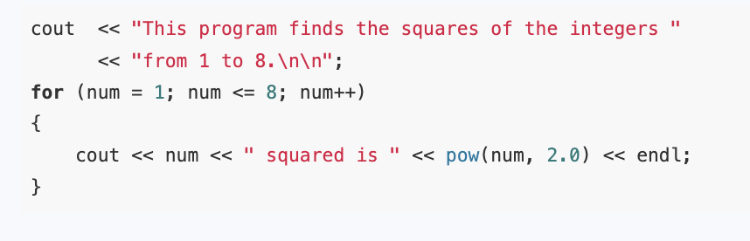
Deciding Which Loop to Use: The for Loop
The for loop is a pretest loop with built-in expressions for initializing, testing, and updating a counter variable. The for loop is ideal in situations where the exact number of iterations is known.

Slide 38
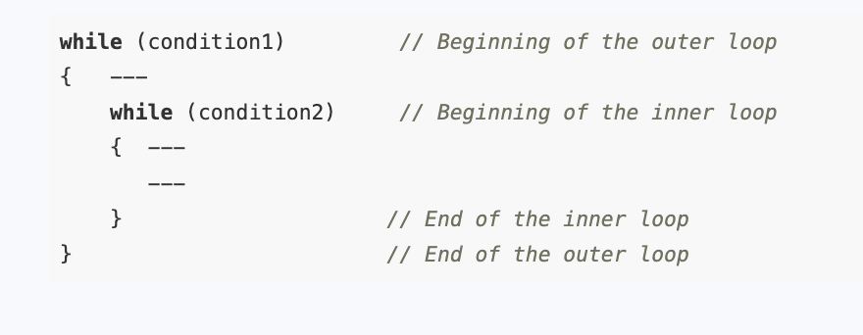
Nested Loops
A loop that is inside another loop is called a nested loop.

Slide 39
Exercise
Write a C++ program that calculates the average test scores for multiple students. The program first asks the user to input the number of students and the number of test scores each student has. It then iterates over each student, prompting the user to enter the individual test scores for that student. After collecting the scores, the program calculates and displays the average score for each student. The process continues until the average for every student is computed and shown. The program ensures that it properly handles multiple students and their respective test scores.

Slide 40
Nested loops
An inner loop goes through all of its iterations for each iteration of an outer loop.Inner loops complete their iterations faster than outer loops.
To get the total number of iterations of an inner loop, multiply the number of iterations of the outer loop by the number of iterations done by the inner loop each time the outer loop is done.

Slide 41
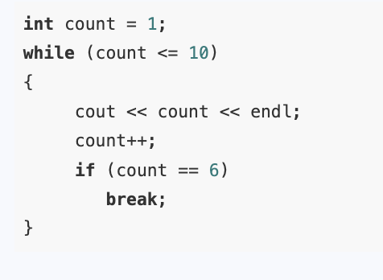
Breaking Out of a Loop
C++ provides ways to break out of a loop or out of a loop iteration early.

Slide 42
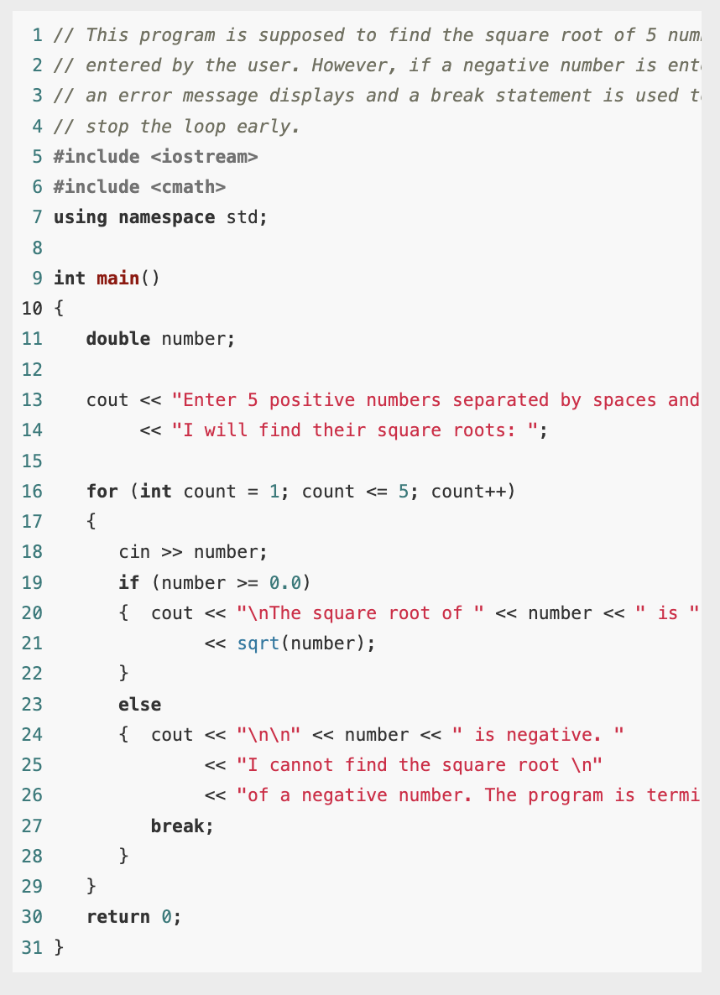

Example

Slide 43

The continue Statement
Sometimes you want to stay in a loop but cause the current loop iteration to end immediately. This can be done with the continue statement.
When continue is encountered, all the statements in the body of the loop that appear after it are ignored, and the loop prepares for the next iteration.

